Slide 1

Analysis of Job Market Trends in the US
Group 6
Notes:
Our Project Topic is the Analysis of Job Market Trends in the US.

Slide 2

Project Overview
This project aims to explore and understand the evolving dynamics of the job market, with a specific focus on the data science field. This project will provide an in-depth analysis of the job market, examining key factors such as high-demand skills, industry trends, geographical hiring hotspots, and other key factors that influence salary.

Slide 3
Questions
1. What skills are in the highest demand for data science?
2. Which industries are in most demand?
3. What locations are hiring the most?
4. How do market trends compare over time?
5. What factors influence salary in todays job market?
Notes:
The questions we aim to take a deeper dive into are:

Slide 4
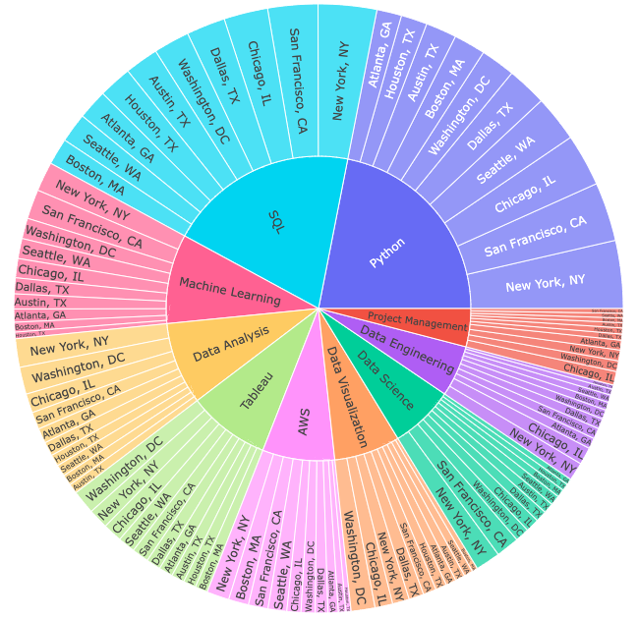
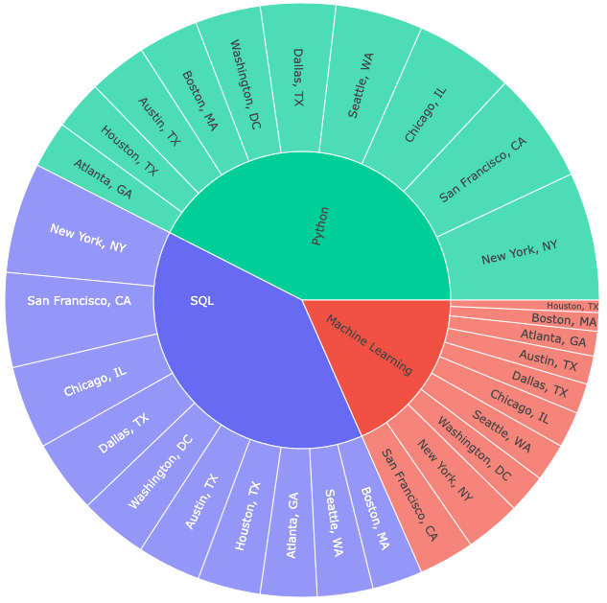
What skills are in the highest demand for data science?
Top 3 Skills in Demand:
Python 21.9%
SQL 20.1%
Machine Learning 9.4%
Top Cities for These Skills:
New York, NY: Strong demand for Python and SQL
San Francisco, CA: Strong demand for Python and SQL
Chicago, IL: Also a top location for Python and SQL
Washington, DC: Notable demand for Machine Learning
Notes:
The dataset we are reviewing to answer our first question “What skills are in the highest demand for data science?” is from Kaggle and pulled from LinkedIn. This data was filtered down to focus on the top 10 skills in the 10 ten locations. In the initial sunburst graph we see the top 10 skills appear by default, with the corresponding top 10 locations for each skill.
*read and hover over each one*
Python, SQL, and Machine Learning take up the top half of the graph and our our top 3 skills in demand in 2024 from this analysis. To take a closer look at these three alone, we can select these from the dropdown.
Python came number at 21.9%
SQL at 20.1%
Machine Learning at 9.4%
New York, San Francisco, and Chicago came in as the top three locations for both Python and SQL, with Washington, DC making a noteable top 3rd location for Machine Learning.

Slide 5
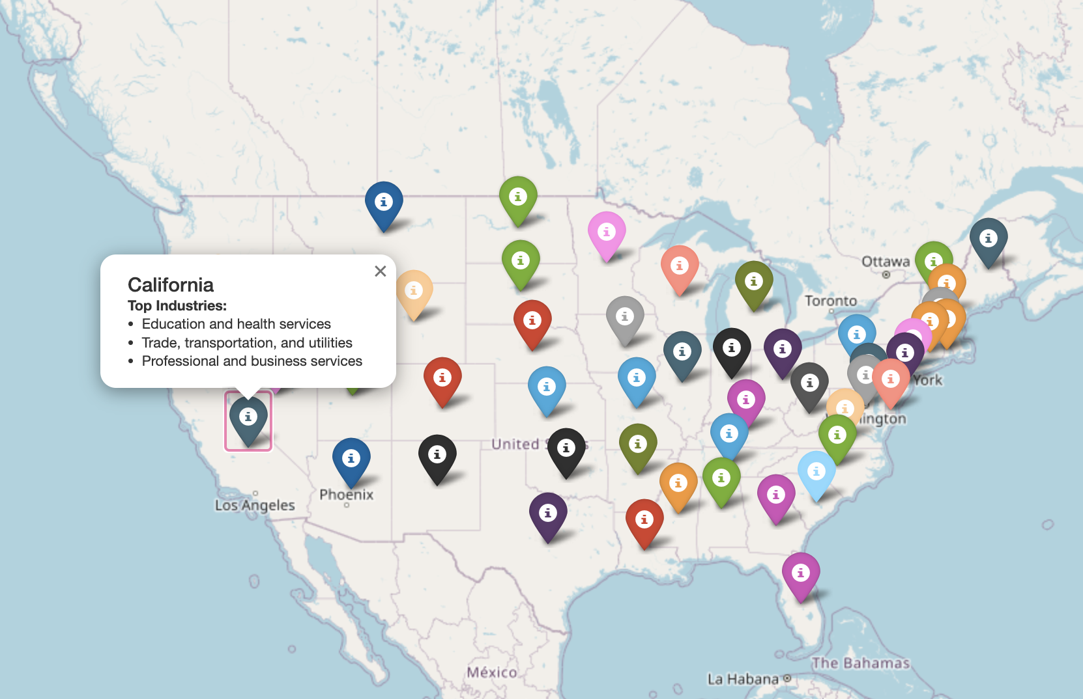
Which industries are in most demand?
Industries in Demand:
Correspond to sectors experiencing growth or increased needs, leading to more job opportunities.
Example Insight:
If 'Healthcare' is a high-demand industry in multiple states, it suggests that healthcare facilities in those areas are actively hiring to meet increasing demand.
Value for Job Seekers:
The map can help job seekers align their career paths with regional industry needs, offering insights into areas with economic growth.
Limitation:
The map highlights broad industry demand rather than specific job titles or individual job openings.

Slide 6
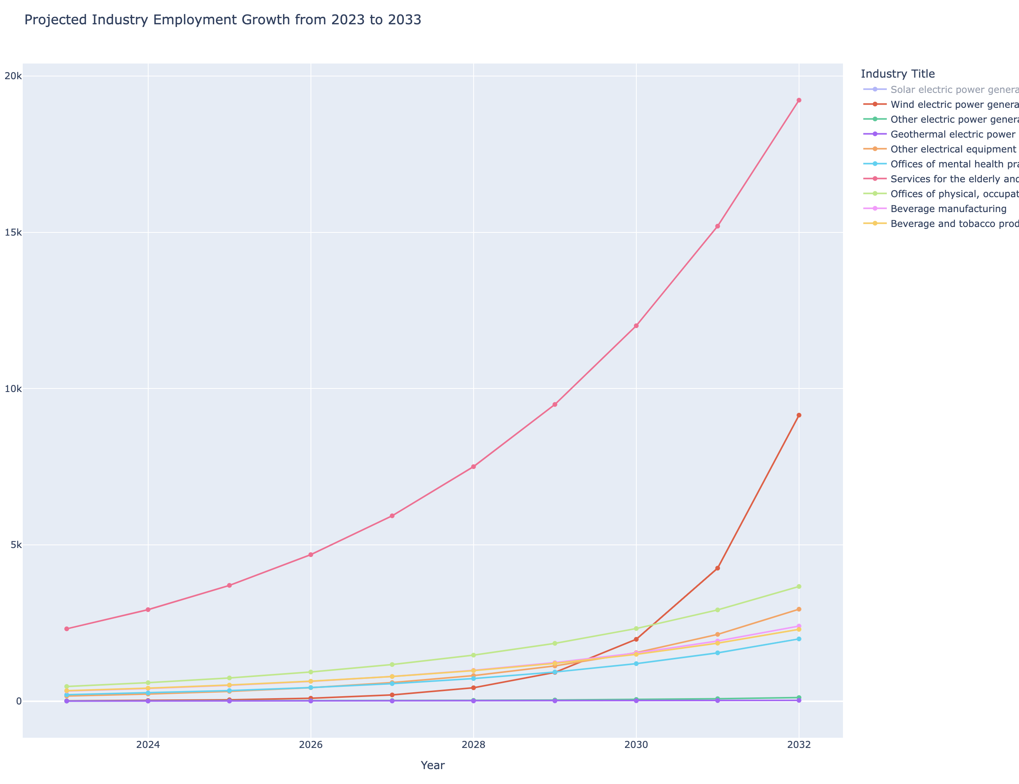
Which industries are in most demand?
Industries in Demand:
The line chart illustrates projected employment growth from 2023 to 2033 for the top 10 fastest-growing industries in the U.S., providing a national overview of job demand trends.
Example Insights:
Renewable energy sectors, such as solar and wind power generation, show steep growth projections, highlighting the increasing demand for clean energy jobs nationwide.
Healthcare-related industries for the elderly are among the top growing industries, aligning with findings from the interactive map, which shows healthcare as a leading industry across multiple states.
· Beverage manufacturing and beverage/tobacco product manufacturing also appear in the top 10, showing consistent demand within the U.S. manufacturing sector.
Value for Job Seekers:
· Together with the map, this line chart provides both state-level and national perspectives on industry demand.

Slide 7
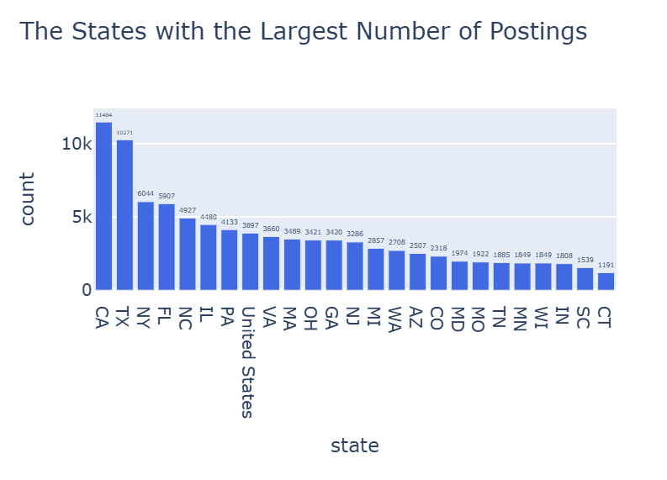
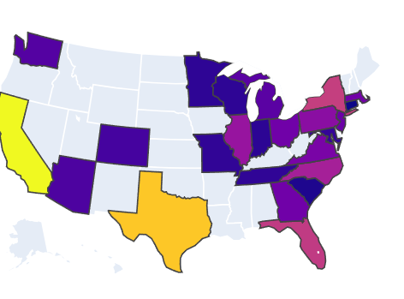
What locations are hiring the most?
These maps show the top 25 states with the most job postings
California and Texas leading heavily as the top two locations
New York, Florida, and North Carolina rounding out the top five
United States is a filler for Remote workers located anywhere in the US

Slide 8
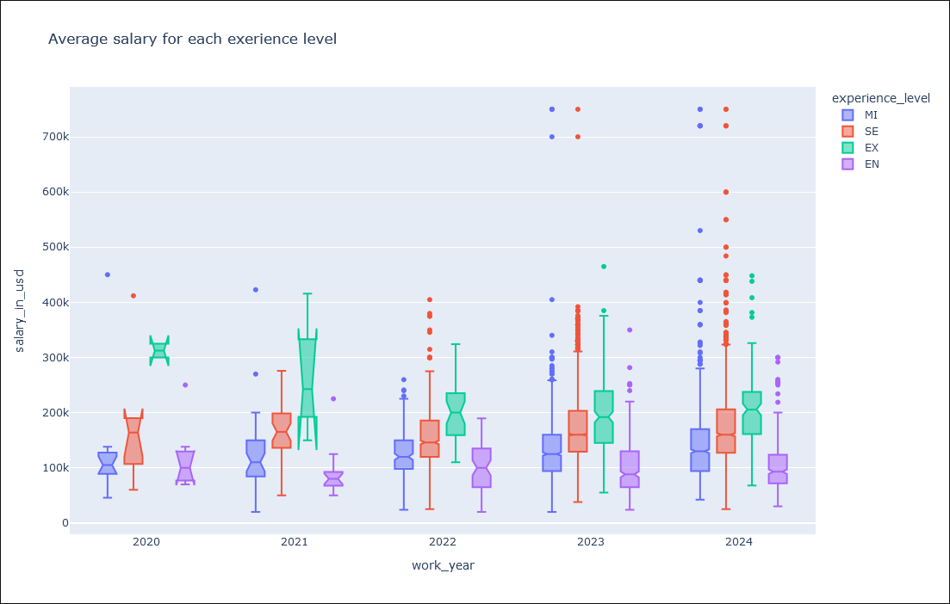
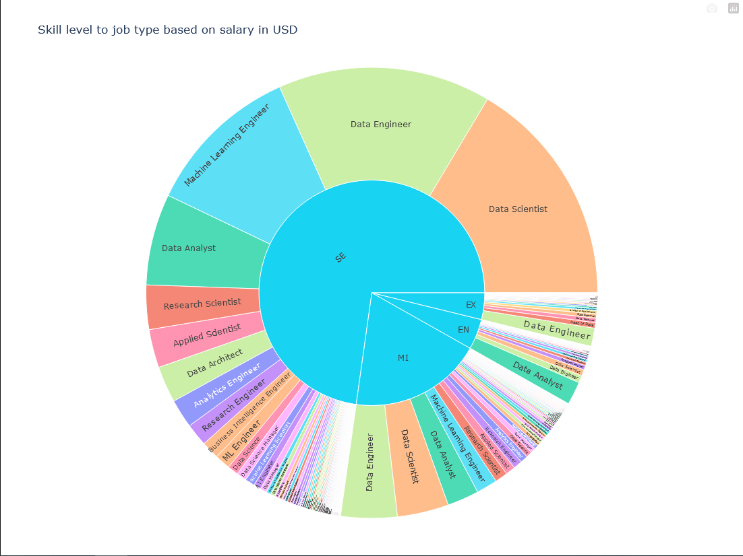
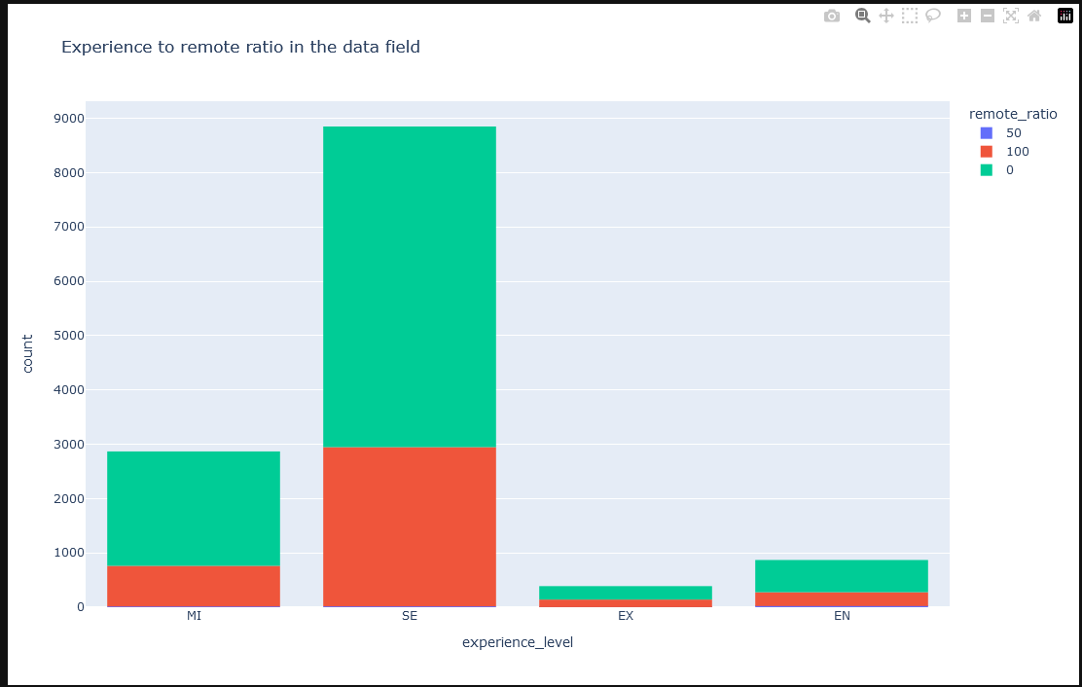
How do market trends compare over time?
The box plot show that executive, senior, and mid level average salary increased over year while entry level was staggered over the years.
Over 4 years the bar graph shows a lot more people work in office compared to remote.
The sunburst chart shows that senior level people make most of the work force, and their fields are data scientist, data engineering, and machine learning engineering.

Slide 9
How do market trends compare over time?
2020 (Covid Years):
Executives and senior-level professionals earned more on average compared to previous years.
Mid-Level Professionals:
Average earnings have been steadily increasing each year from 2020 to 2024.
Entry-Level Professionals:
Average earnings have remained relatively stagnant over the years.
There are larger outliers in 2023 and 2024, indicating occasional spikes in earnings for some individuals.

Slide 10
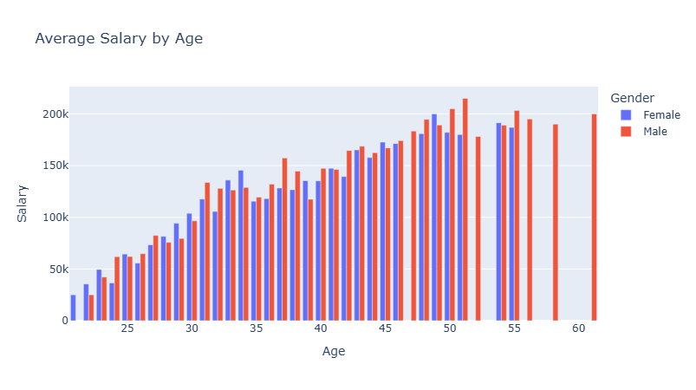
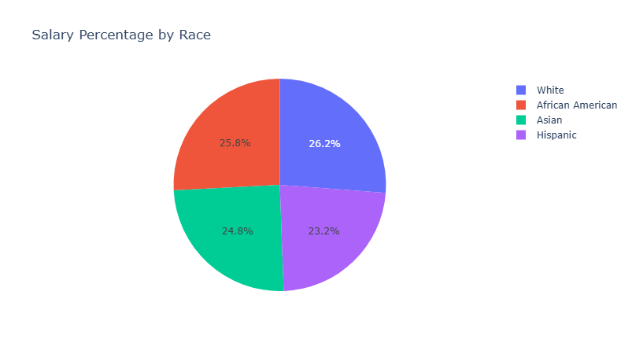
What Factors influence Salary in Todays Job Market?
Age:
The average salary difference between a 25-year-old and a 50-year-old is nearly $150,000.
Experience:
Data shows that individuals with more job experience are significantly more likely to earn higher salaries.
Gender:
Males earn, on average, 15% more than females in the current job market.
Education:
Workers with only a high school diploma earn around $30,000 annually, while those with a PhD earn over $100,000 on average.

Slide 11
Analysis & Conclusion
This presentation on the "Analysis of Job Market Trends in the US," provides a comprehensive overview of the current landscape in the U.S. job market, with data science serving as one example within a broader analysis. The project explores demand across high-growth industries, skill requirements, geographic hiring hotspots, and factors influencing salary disparities.
A key component of the analysis focuses on high-demand skills in Data Science like Python, SQL, and Machine Learning, which are representative of the types of technical abilities employers seek, particularly in tech-forward cities like New York, San Francisco, and Washington, DC. The project highlights high-demand industries, such as healthcare, renewable energy, and manufacturing, which are pivotal sectors contributing to job growth and regional economic development.
The geographic and salary trends reveal critical patterns, with states like California, Texas, New York, and Florida as hiring hotspots. Salary growth trends vary, with executive and senior-level roles experiencing steady increases, while entry-level positions face wage stagnation, presenting challenges for newcomers. Additionally, the project underscores the impact of demographic and educational factors on income; age, experience, gender, and education level substantially influence earnings, with education (from high school to PhD) strongly correlating with salary levels. This comprehensive examination offers job seekers insights into industry needs, skill alignment, and the strategic positioning required to thrive in a competitive job market.

Slide 12

Thank you

